Slide 1
Office Hours Management System (OHMS)
Sponsors: Guy Beaulieu
Team Members:
Claude White
Jacob Morrency
Matteo Falasconi
Pax Bertin Izabayo
Notes:
Project name – pick a cool sounding name for your project
Sponsors – list your project sponsors here (the people with the money)
Putting your sponsors name boldly out there for all to see is a great way to get their engagement and attention (necessary for any successful project).

Slide 2
The elevator pitch
For [Guy Beaulieu]
who [needs keep track of office hours and student appointments]
the [Office Hours Management System]
is a [specialized scheduling tool]
that [helps build your office hours schedule and helps students book teachers office hours].
Unlike [Outlook Calendar]
our project [application integrates with the school system and automates tedious tasks].

Slide 3
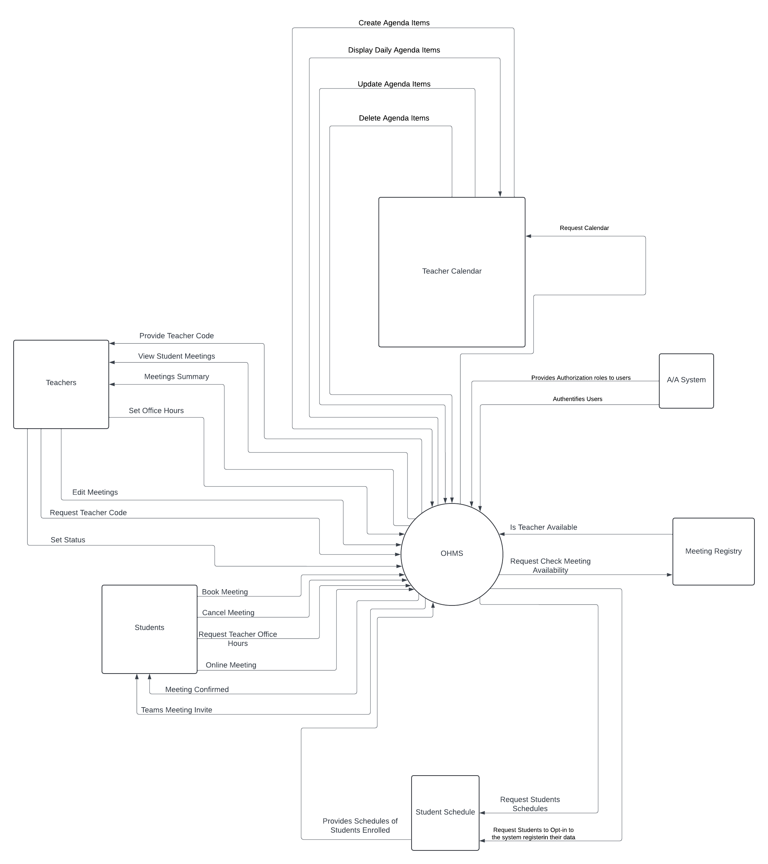
System context
Notes:
Include the context diagram here
See: https://en.wikipedia.org/wiki/System_context_diagram for details

Slide 4
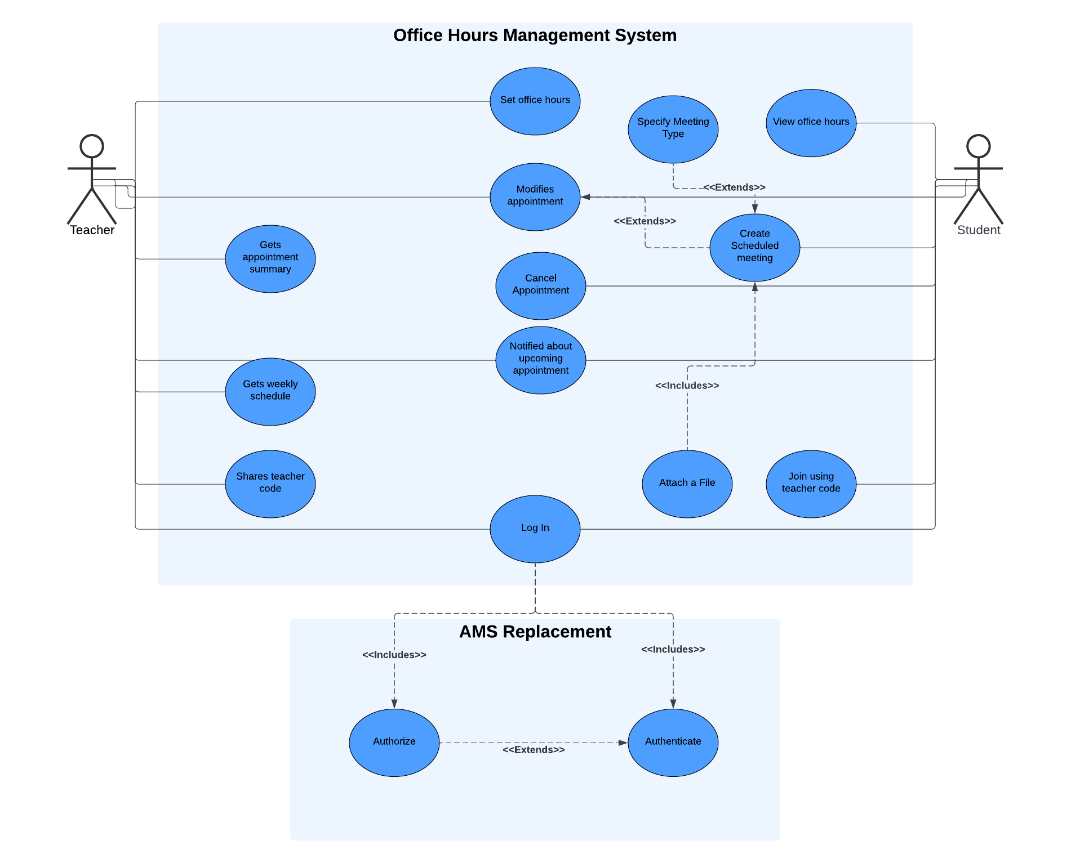
Use Case Diagram
Notes:
Include the context diagram here
See: https://en.wikipedia.org/wiki/System_context_diagram for details

Slide 5
The NOT list
Release 1 | Release 2
Teacher Set Office Hours | Access App From Anywhere (HIAAA)
Display Appointments Summary | Teacher Status (available, away, etc)
Create, Update, Delete, View Appointments as teacher | Teacher Codes
Create, Update, Delete, View Student Appointment | File Upload
Out
No priority system
No appointment history
Notes:
List all the big ticket items you are (and are NOT) going to deliver within the scope of this project.
Before starting your project move all the UNRESOLVED ones to either IN or OUT.

Slide 6

Technical solution
Technologies Stack
User Interface
User
Database
Entity Framework Core
Business Logic (System Rules & Workflow)
OHMS Web Interface
Model View Controller Pattern
Object Relational Mapper
SQL Server
C#
JavaScript
SQL
Toast Notifications
HIAAA(Team #1 Dev Project)
Technologies:
C#, JavaScript, SQL, Entity Framework Core
Toast Notifications, HIAAA, .NET
Visual Studio 2022, Rider, MSSQL, Azure DevOps, Git, SQL Server (RDBMS), Chrome, Safari, Edge, Firefox.
.NET
Notes:
This is about letting people know how we plan on building this thing.
If there are any tools or libraries assumptions you are making list them here.
Also if there are areas of the application architecture that are risky highlight those too.
This is to end up looking like a high level deployment diagram. Show the user the key pieces, DB server, web server, browser and let them know where code is running.
Doesn’t have to be a formal deployment, but convey the platforms.
Get browser requirements if a web application.

Slide 7

What keeps us up at night
How to automate sending a daily email with the current day's schedule
How to access student's and teacher's schedules
How to make the application accessible from outside the school's network
How to include the creation of Teams Online invitations link to our system (will we be allowed to use Microsoft Graph or not. If we aren’t what external online meeting services can be used and will be allowed like Zoom could be an alternative).
Notes:
This is your chance to call out any craziness you’ve heard while building the deck, and having a frank conversation with your sponsors and your team about how you are going to handle it.
This is perhaps on of the most powerful slides in the deck – it’s your chance to ask for whatever you need to be successful and the consequences if you don’t get it.
Use it!

Slide 8

How big is this thing?
Ship it!
Construction
UAT
Training
~3months
1 wk
1 wk
This is a guess. Not a commitment.
Notes:
Give your sponsors some idea of how big this thing is (1, 3, or 6 monther).
Before you can complete this slide you and the team should create and estimate a high-level story list for the project.
This isn’t a commitment (too many unknowns). It’s just a really rough guess. Don’t treat it as anything else.

Slide 9
Trade-off sliders
 | The classic four
 | Feature completeness (scope)
 | Stay within budget (budget)
 | Deliver project on time (time)
 | High quality, low defects (quality)
OFF
ON
OFF
ON
OFF
ON
OFF
ON
 | Other important things
 | Ease of use
 | Security
 | Scalability
 | Documentation
OFF
ON
OFF
ON
OFF
ON
OFF
ON
Notes:
When push comes to shove, something has to give. Here we want to be clear on what that is.
On agile projects we flex on scope. But there could be others factors at play here so get ready to listen as you customer tells you which forces can bend (scope) and which are written in stone (usually budget).
Slider rules:
1. No two sliders can occupy the same level.
2. List other important project factors down below.

Slide 10
User Stories Priorities
Priority | User Stories
1 | As a teacher, I want to be able to set my office hours, so that students can see when I'm available
2 | As a student I want to be able to schedule meetings for a teacher, so that I can notify them of my intentions
3 | As a teacher I want to be able to see my office hours for the week, so that I can know what my week looks like
4 | As a teacher I want to be able to override appointment details, so that I can free up my office hours in case of a change
5 | As a student I want to be able to cancel the meeting, so that I can notify the teacher that I will not be able to attend
6 | As a teacher I want to be able to share my classroom code, so that students can have access to my office hours schedule
7 | As a student I want to be able to see the teacher's office hours, so that I can properly assign meeting times within the teacher’s office hours
8 | As a student I want to be able to be able to specify whether the meeting is in-person or virtual, so that the teacher and I can discuss and create a team meeting
9 | As a teacher, I want to get a summary of my appointments for the day, so that I can see what I have for the day
10 | As a teacher I want the system to recommend some time slots for office hours, so that I can easily see the best time slots
11 | As a student I want to be able to know if the teacher is not able to go to the school, so that I can assess the best next possible time to have a meeting
12 | As a user I want to be able to access the application from anywhere, so that I can book/see my office hours from anywhere
13 | As a teacher I want to be able to have an away from office status, so that students know I am away right now
14 | As a student I want to be able to give a meeting description and be able to attach a file, so that I can give greater context to the teacher
15 | ***Outstanding As a teacher I would like to have to ability to have two concurring event display in my personal calendar
Notes:
Go over this board with the Client, Evaluate whether or not the priorities where properly evaluated and listed in order of priority.
Make modifications based upon the feedback of the client.

